Slide 1

ANZ Internship
Shashank Raj
PGPM in Analytics

Slide 2
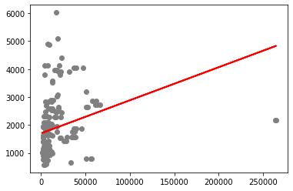
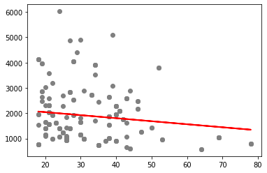
Task 2 : Simple Linear Regression
For Balance vs Salary
MAE: 801.3741
MSE: 1109153.98
RMSE: 1053.16
For Age vs Salary
MAE: 799.703
MSE: 1067082.396
RMSE: 1032.996

Slide 3
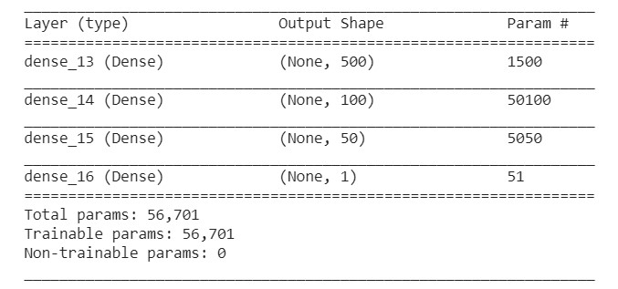
Task 2: Using DNN
Dependent Variable: Salary
Independent Variables: Age, Balance
4 Layer DNN: 1 Input, 2 Hidden, 1 Output
Activation Function: Relu
Optimizer: Adam
Epochs: 500
MSE Train: 1277.8
MSE Test: 1328.4

